Slide 1
MON&BS usage for EO Conformance Test support (NA-MON)
ICS2 Release 2 CT Campaign (July 2022 – February 2023)
May 2022

Slide 2
Agenda
The role of national service desk and national project team in EO Conformance Testing
The purpose of the MON user interface
MON user interface use cases
Consult the trader preferences;
Modify one trader preference;
Create a new trader with his/her respective preferences;
Manage one trader preference;
Consult the EO Self-conformance Test Campaigns, (consult the Business Scenarios of each Test Campaign and consult the Messages of each Business Scenario )
Consult successful EO Self-conformance testing;
Upload successful EO Self-conformance testing;
Search EO messages not compliant with a successful Self-Conformance testing.

Slide 3
1. The role of national service desk and national project team in EO Conformance Testing
National Service Desk (NSD)
The National Service Desk is responsible for the following activities:
• Follows-up and provides assistance to EO through ICS2 MON&BS during Self-conformance test campaign;
• Logs any issues/incidents found during EO Self-Conformance Test campaign that need to be investigated by National Service Helpdesk or Central Service Desk;
• Resolves any issue/incident that occurred during the EO Self-Conformance Test campaign or dispatching them to Central Service Desk in case this is related to ICS2 central components;
• Follows-up the CT incidents and shares the provided feedback to relevant EOs.
Notes:
Iskreno, nije mi jasno što bi mi tu imali za nadgledati. Nekako mi je najlogičnije da ako će godpodarstvenik imati neki problem da nam onda pošalje mail i tada bi onda mi mogli nešto pomoći.

Slide 4
1. The role of national service desk and national project team in EO Conformance Testing
National Service Desk (NSD)
In the interaction with EOs, National Customs Authority is represented by its National Service Desk (NSD)
National Customs Authority (NA)
National Service Desk (NSD)
Notes:
Za ovo smo već konstatirali da neće biti HD već ti i ja

Slide 5
1. The role of national service desk and national project team in EO Conformance Testing
National Customs Authority / National ICS2 Project Team
The role of National Customs Authority (or dedicated National ICS2 Project Team) is to be the SPOC for CT requests by the Sender. Specifically, the National Customs Authority is responsible for the following activities:
• Ensures the communication, the coordination and the schedule with the EO;
• Provides the EO CT plan to DG TAXUD ICS2 Project Teams;
• Verifies and validates the sealing certificate registration by the EO;
• Organise and deliver training to EOs;
• Register Economic Operators. This shall be provided by Member States using other systems: EOS (Economic Operator Systems) and UUM&DS;
Notes:
Točku 1 - smo napravili
Točku 2 - smo napravili
Točku 3 - ćemo napraviti
Točka 4 – ne znam na kakav trening misle
Točka 5 – CA je već registrirana kod nas, još samo da se riješi točka 3

Slide 6
1. The role of national service desk and national project team in EO Conformance Testing
National Customs Authority / National ICS2 Project Team
•Manages processes related to the registration, identification and maintenance of the identities of the Economic Operators and their representatives, in their Identity and Access Management (IAM) systems, connected to the UUM&DS;
• Provides to EOs the UUM&DS user-roles in CONF environment needed to access EUCTP, and consequently the STI-STP;
• Checks the business and technical readiness of the Trader before they start to send ENS to the STI;
• Provides the service desk support to EOs for CT related incidents;
• Acts as an escalation point along with DG TAXUD ICS2 Project Team.
Notes:
Točka 1 – koliko ja razumijem to je u domeni CA
Točka 2 – ovo će biti provedeno kada se u G2B registriraju za ICS 2
Točka 3 – ne razumijem na što misle
Točka 4 – ovo bi, ako sam dobro razumio, napravili Ti i ja
Točka 5 – ovo je nadovezano na točku 4

Slide 7
2. The purpose of the MON user interface
MON&BS as Supportive Tool
MS operators shall access ICS2 Monitoring and Business Statistics tool in CONF environment to consult the registered EO Self-Conformance Test campaigns and to follow up the execution of the related business scenarios. The aim is for MS to provide meaningful assistance to EO during Self-Conformance Test campaign.
MON&BS: https://u2s.conf.ccn2.taxud/
It is important to highlight that the use ICS2 MON&BS tool is available only to MS and EC users.
EO can manage ICS2 related preferences and Self-register a conformance test campaign through the STI-STP. In this case, the execution of the Campaign will be tracked by STI. Self-registration of conformance test campaign is implemented through STI-STP in the CONF environment.
Notes:
Ovaj link nije u funkciji, ali koliko se ja sjećam, ovdje misle na https://u2s.conf.ccn2.taxud/ics2-mon/screen/home

Slide 8
2. The purpose of the MON user interface
MON&BS as Supportive Tool
With the Member State Service Support – Monitoring Operator role a user is involved in the following use cases:
• Management of Trader Preferences:
Consult the trader preferences;
Modify a trader preference;
Create a new trader with his/her respective preferences;
Manage a trader preferences.
Notes:
Ovo je po meni sve odrađeno

Slide 9
2. The purpose of the MON user interface
Any of both roles could be assigned for the below actions
MON&BS as Supportive Tool
With the Member State Service Support – Monitoring Operator or Member State Service Support – Message Operator roles, a user is involved in the following use cases:
EO Self-Conformance Test Campaign:
Consult the EO Self-Conformance Test campaigns (consult the business scenarios of each test campaign and consult the messages of each business scenario);
Consult successful EO Self-Conformance Testing;
Upload successful EO Self-Conformance Testing;
Search EO messages not compliant with a successful Self-Conformance Testing.
Notes:
Iskreno i dalje mi nije jasno što mi trebamo ako oni sve testiraju sami sa STI.
Tu bi im STI trebao odgovarati.
Osim ako ne misle da kada EO ima problem da onda kontaktira nas i tada mi pogledamo i vidimo u čemu je problem

Slide 10
3. MON user interface use cases
Manage Trader Preferences Use Cases
This section defines all the basic flow use cases provided for the Management of the Trader Preference, carried out by the Member State Service Support – Monitoring Operator actor.
The aims of these use cases is to provide a better assistance to the trader.
In practice, the user can:
Consult the Trader Preferences;
Modify a Trader Preference;
Insert a new Trader with his/her respective preferences;
Manage a Trader preference.

Slide 11
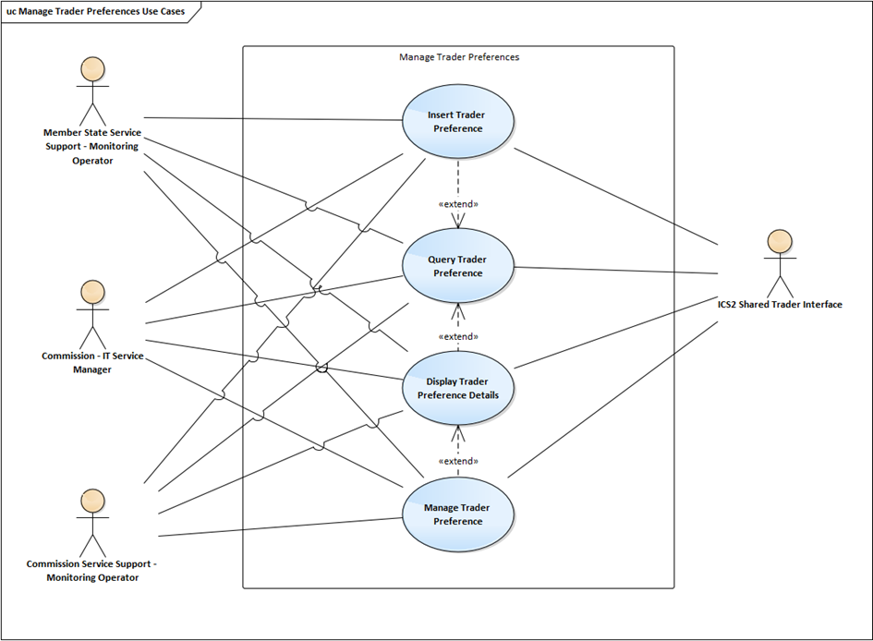
3. MON user interface use cases
Manage Trader Preferences Use Cases

Slide 12
3. MON user interface use cases
Manage Trader Preferences Use Cases
The Member State Service Support – Monitoring Operator user can:
Query Trader preferences
Insert Trader preferences
Manage Trader preferences
Display Trader preferences

Slide 13
3. MON user interface use cases
Manage Trader Preferences: Query Trader Preferences
This use case provides to the user the ability to query for existing trader preferences
The user enters the EORI number of the searched EO and select to proceed with this query;
The system displays the trader preference matching the EORI from the query criteria and with a validity period valid at the time of the query.
The user has access to the trader configuration matching the EORI from the query criteria

Slide 14
3. MON user interface use cases
Manage Trader Preferences: Query Trader Preferences
The following information is displayed in a grid:
EORI (clickable link)
Contact Details:
Name;
Email address;
Phone number.
The user has access to the trader configuration matching the EORI from the query criteria
In the next slides there is graphical representation of MON&BS UI regarding the “Query Trader Preferences” functionality

Slide 15
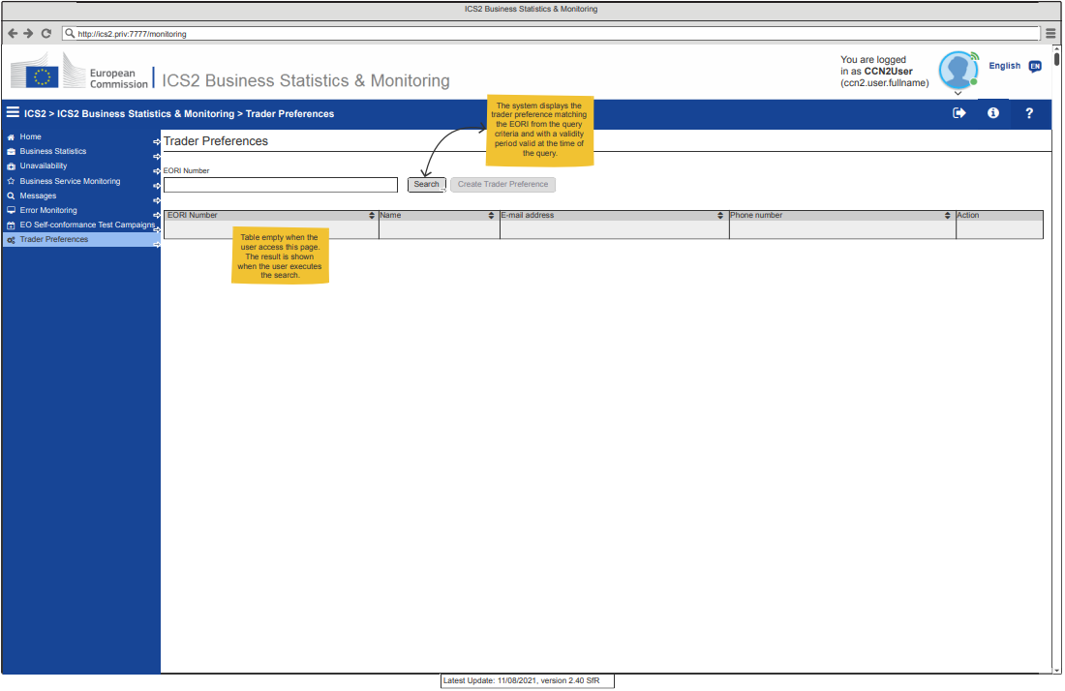
3. MON user interface use cases
Manage Trader Preferences: Search a Trader
Notes:
Ovdje bi mi trebali upisati EORI od CA i onda vidjeti njegove podatke

Slide 16
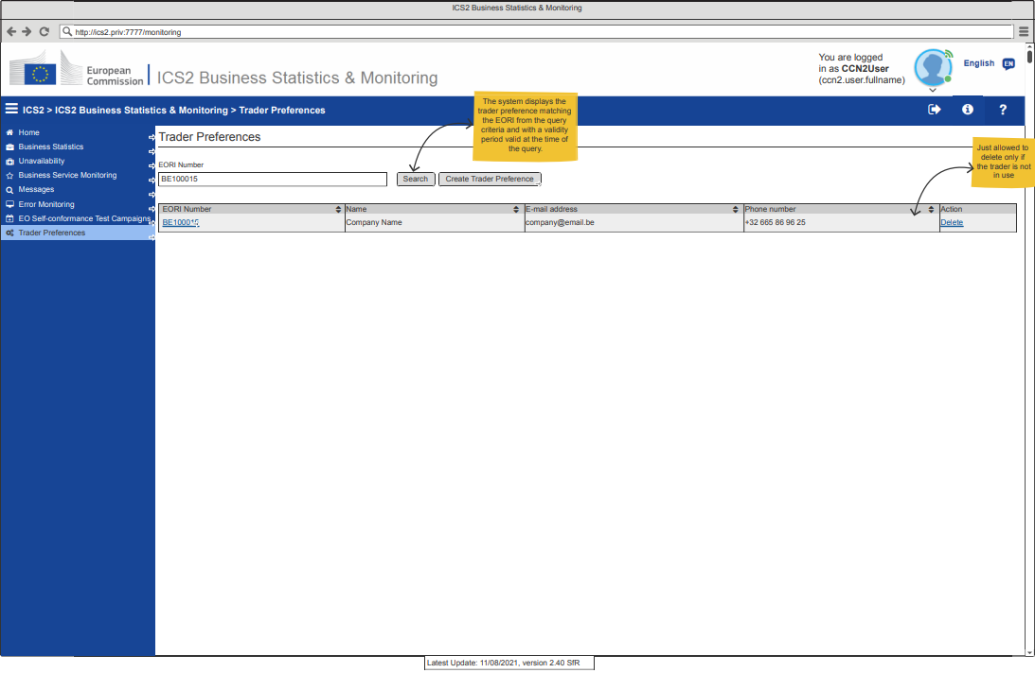
3. MON user interface use cases
Manage Trader Preferences: Search a Trader

Slide 17
3. MON user interface use cases
Manage Trader Preferences: Insert Trader Preferences
This use case provides to the user the ability to insert a new trader with the respective preferences, using the UI of ICS2 Monitoring.
The user selects to insert a new trader preference;
The system displays the page dedicated for the insert of a new Trader Preference.
The following information is enabled for the user to fill in:
Trader Information:
EORI
Contact Details:
Name;
Email Address;
Phone Number.

Slide 18
3. MON user interface use cases
Manage Trader Preferences: Insert Trader Preferences
Notification preferences: The system allows the user to switch ON/OFF the notifications
System Configuration: The system allows the user to configure the list of one or more parties. The following information must be defined:
PartyId such as <system>@<EORI>@<MS>, where <system> and <MS> are optional;
Endpoint URL, which is only required when the Message Exchange Pattern is equal to “push”;
Support STI Service Version;
Message Exchange Pattern (MEP): either push or pull;
Contact Details (Name, E-mail Address, Phone number).

Slide 19
3. MON user interface use cases
Manage Trader Preferences: Insert Trader Preferences
Default Communication Path: The system allows the user to configure the list of one or more communication path. The following information must be defined:
Business domain (e.g. “express”, “postal”, etc.);
Communication Path;
PartyId.
The trader can only have one default communication path for each business domain

Slide 20
3. MON user interface use cases
Manage Trader Preferences: Insert Trader Preferences
The user has successfully inserted a new trader preference related to:
Reception of optional Notification;
Configuration of AS4 AP;
Configuration of the default communication path.
In the next slides there is graphical representation of MON&BS UI regarding the “Insert Trader Preferences” functionality

Slide 21
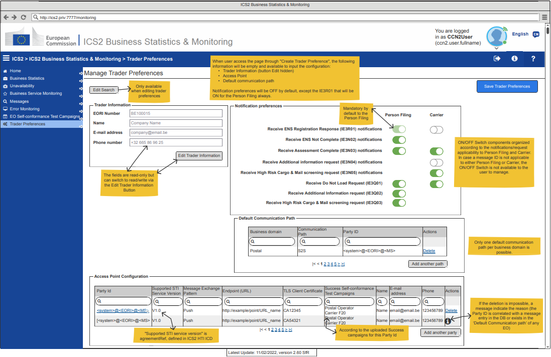
3. MON user interface use cases
Manage Trader Preferences: Create/Edit Trader Preference
The Create / Edit Trader Preferences page is the area where the user can create new preferences for a Trader or consult and edit already existing ones.

Slide 22
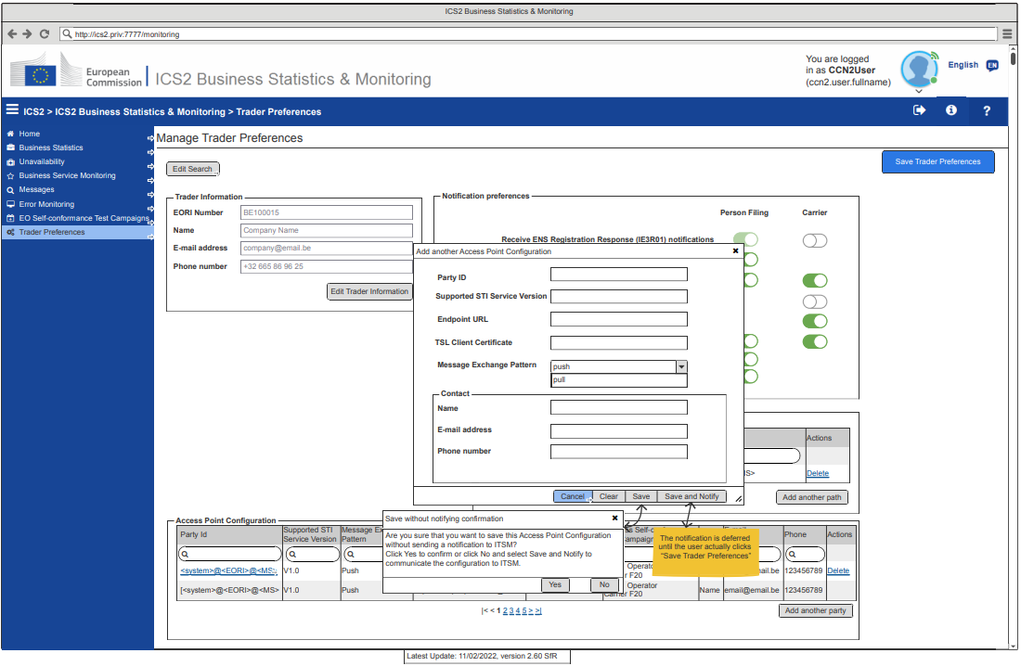
3. MON user interface use cases
Manage Trader Preferences: Add Party Pop-up

Slide 23
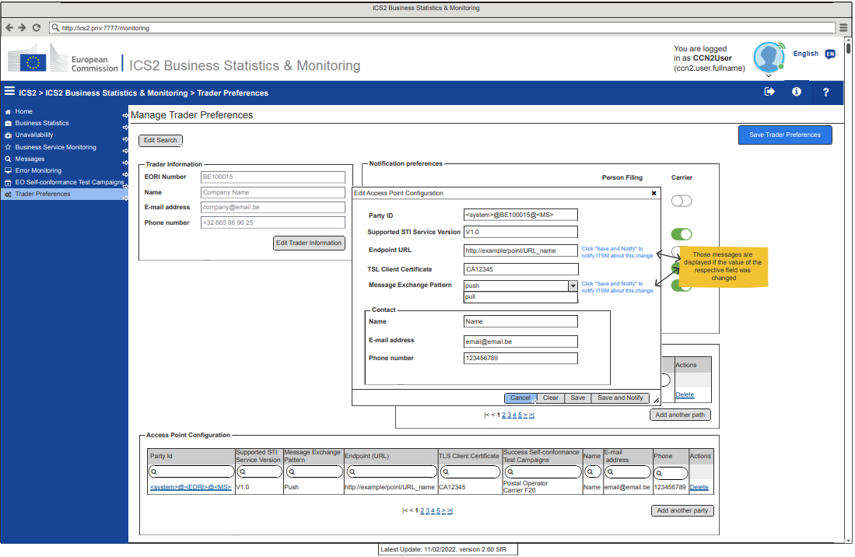
3. MON user interface use cases
Manage Trader Preferences: Edit Party Pop-up

Slide 24
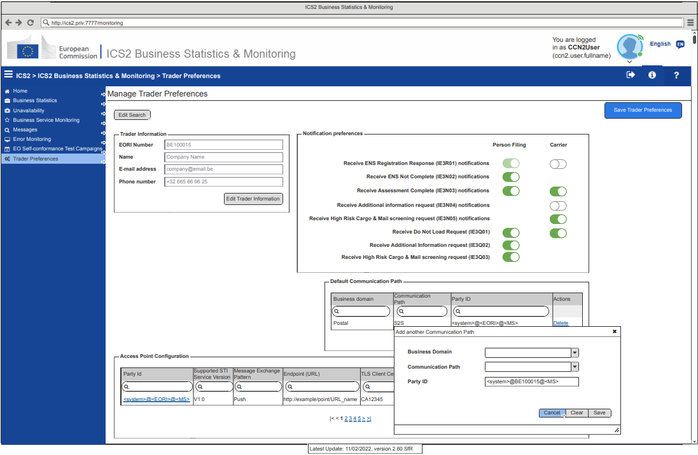
3. MON user interface use cases
Manage Trader Preferences: Add Communication Path

Slide 25
3. MON user interface use cases
Manage Trader Preferences: Display Trader Preferences Details
The user displays the information about a trader preference.
The available information about the trader preference consist of:
Notification preferences, i.e. configuration for notifications the trader requests to receive or not;
System configuration, which displays the trader’s AS4 AP preferences (if information is configured for the reader);
Default communication path, i.e. an entry that represents if a trader is connected to the system and is used solely to retrieve the default partyId in case it is unknown and a messages needs to be sent.

Slide 26
3. MON user interface use cases
Manage Trader Preferences: Display Trader Preferences Details
The user selects to display the information about a trader preference.
The system displays in a dedicated webpage the trader information in read-only:
EORI
Contact Details
Name;
Email Address;
Phone number.
At the same page, the following information about the trader preference is also displayed separately into the following three groups:

Slide 27
3. MON user interface use cases
Manage Trader Preferences: Display Trader Preferences Details
Notification preferences: The list of optional notifications
Default communication path: The system allows the user to see the list of one or more communication path. The following information must be defined:
Business Domain;
Communication Path;
PartyId.
System configuration: The system allows the user to see the list of one or more parties. The following information must be defined:
PartyId such as <system>@<EORI>@<MS>, where <system> and <MS> are optional;
Endpoint URL;
Support STI Service Version;

Slide 28
3. MON user interface use cases
Manage Trader Preferences: Display Trader Preferences Details
Message Exchange Pattern (MEP): either push or pull;
TLS Client Certificate;
Success Self-Conformance Test Campaigns: automatic values according to the Success EO Self-CTCs loaded;
Contact Details (Name, E-mail address, Phone Number).
The user views the trader information and the trader preferences of a specific selected trader

Slide 29
3. MON user interface use cases
Manage Trader Preferences
The user can manage the information about a trader preference and, in addition, the information about the trader.
The user can configure the following information about the trader preference:
Trader Information;
Notification preferences;
System configuration, which contains the trader’s AS4 AP preferences (if information is configured for the trader);
Default communication path.

Slide 30
3. MON user interface use cases
Manage Trader Preferences
The user selects to edit the trader information
The system enables the user to edit the contact details information only (Name / E-mail address / Phone Number)
The user selects to add a new system configuration (AS4 AP)
The system presents to the user a modal pop-up with the following information that must be defined:
PartyId such as <system>@<EORI>@<MS>, where <system> and <MS> are optional and <EORI> is the EORI from the Trader information;
Endpoint URL, which is only required when the Message Exchange Pattern is equal to “push”;
Support STI Service Version;
Message Exchange Pattern (MEP): either “pull or “push”;
TLS Client Certificate;
Contact Details (Name, E-mail address, Phone Number).

Slide 31
3. MON user interface use cases
Manage Trader Preferences
The user selects to add new default communication path
The system presents to the user a modal pop-up with the following information that must be defined:
Business domain;
Communication path;
PartyId.
The user selects to delete a system configuration or a default communication path;
The system presents a pop-up requesting the user confirmation to proceed with deletion.
The system persists the action that was taken by the user

Slide 32
3. MON user interface use cases
EO Self-Conformance Test Campaign Use Cases
This section defines all the basic flow use cases provided to consult the registered Self-Conformance Test Campaigns and to follow up the execution of the related Test Cases.
In practice, the Member State Service Support – Monitoring Operator & Member State Service Support – Message Operator can:
Consult the EO Self-Conformance Test Campaigns (consult the Business Scenarios of each Test Campaign and consult the Messages of each Business Scenario);
Consult successful EO Self-Conformance testing;
Upload successful EO Self-Conformance testing;
Search EO messages not compliant with a successful Self-Conformance testing.

Slide 33
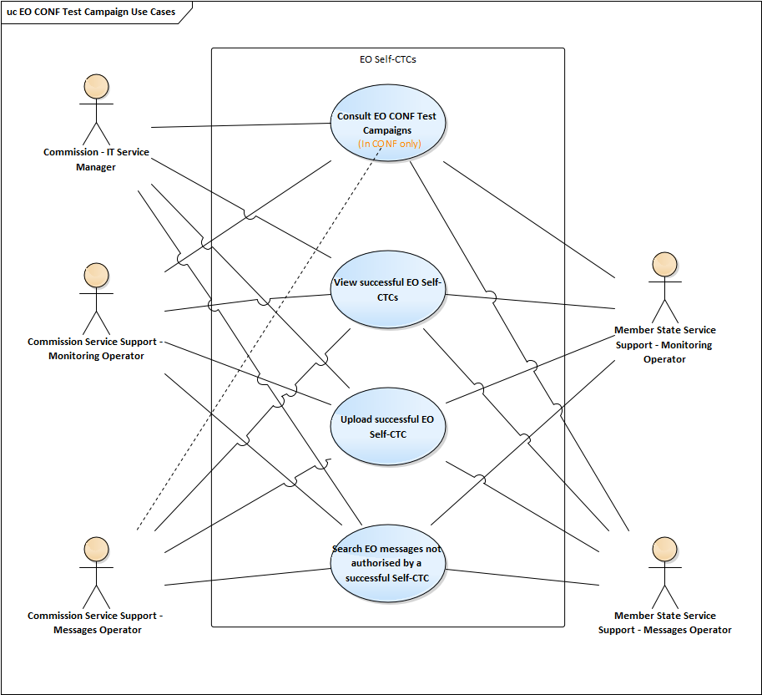
3. MON user interface use cases
EO Self-Conformance Test Campaign Use Cases

Slide 34
3. MON user interface use cases
EO Self-Conformance Test Campaign Use Cases
The Member State Service Support – Monitoring Operator or Member State Service Support – Message Operator can:
Consult the EO Self-Conformance Test Campaigns
Consult successful EO Self-Conformance testing
Search EO messages not compliant with a successful Self-Conformance testing
Upload successful EO Self-Conformance testing

Slide 35
3. MON user interface use cases
EO Self-Conformance Test Campaign: Consult EO-Self CTC
This use case provides to the user the ability to consult the self-registered EO Test Campaigns.
The user accesses the EO Self-Conformance Test Campaigns webpage.
The system presents:
Information related to the active Test Scenario:
Name;
Start Date;
End date.

Slide 36
3. MON user interface use cases
EO Self-Conformance Test Campaign: Consult EO-Self CTC
The available search criteria to search campaigns:
Sender PartyId
Business Role, possible values:
Postal Operator;
Express Operator;
Carrier;
House Filer;
Notify Party;
Person notifying the arrival.

Slide 37
3. MON user interface use cases
EO Self-Conformance Test Campaign: Consult EO-Self CTC
ENS Filing type, possible values depending on the Business Role selected:
For Carrier: F20, F21, F27, F28, F29 and F42
For House Filer: F22, F23, F25, F24 and F26
Campaign Status
Registration Date
If none of these Business roles is selected the ENS Filing type field will not be displayed, otherwise it is a mandatory field

Slide 38
3. MON user interface use cases
EO Self-Conformance Test Campaign: Consult EO-Self CTC
The user enters the intended search criteria and selects to search Conformance Test Campaigns
The system presents a grid with the Campaigns matching the inserted criteria, sorted by descending Registration Date, with the columns:
Sender PartyId;
Business Role;
ENS Filing Type;
Registration Date;
Status;
Action (View).

Slide 39
3. MON user interface use cases
EO Self-Conformance Test Campaign: Consult EO-Self CTC
The user selects to view an EO Test Campaign
The system presents a grid with the Business Scenarios of the EO Test Campaign, with the columns:
Sender PartyId;
Business Role;
ENS Filing Type;
Business Scenario;
Business Scenario Status;
Action (View).

Slide 40
3. MON user interface use cases
EO Self-Conformance Test Campaign: Consult EO-Self CTC
The user selects to view a Business Scenario
The system presents a grid with the Messages of the Business Scenario, with the columns:
Step sequence is the same as defined in “ICS2 Test Design Specifications for Economic Operator Conformance Test Cases R2”. In a case a step included more than one message then all these messages will have the same step sequence number:
Message Type;
Identifier;
Optionality;
Execution Date;
STI status;
Action (View).

Slide 41
3. MON user interface use cases
EO Self-Conformance Test Campaign: Consult EO-Self CTC
The user selects to view a Message with status Failed/Success
The “View a message” action is only available for messages with Status Failed / Success
This Use case is only available in the Conformance Environment
Member States users, are represented in this use case by the actor Member State Service Support – Monitoring Operator, access only to CONF Test Campaigns where their own country is involved. This is done based on the Sender PartyId if present or on the EORI number

Slide 42
3. MON user interface use cases
EO Self-Conformance Test Campaign: Consult EO-Self CTC
The user has access to consult the EO Self-Conformance Test Campaigns, their Business Scenarios and their Messages status, in the Campaign Context.
In the next slides there is graphical representation of MON&BS UI regarding the “EO Self-Conformance Test Campaign” functionality

Slide 43
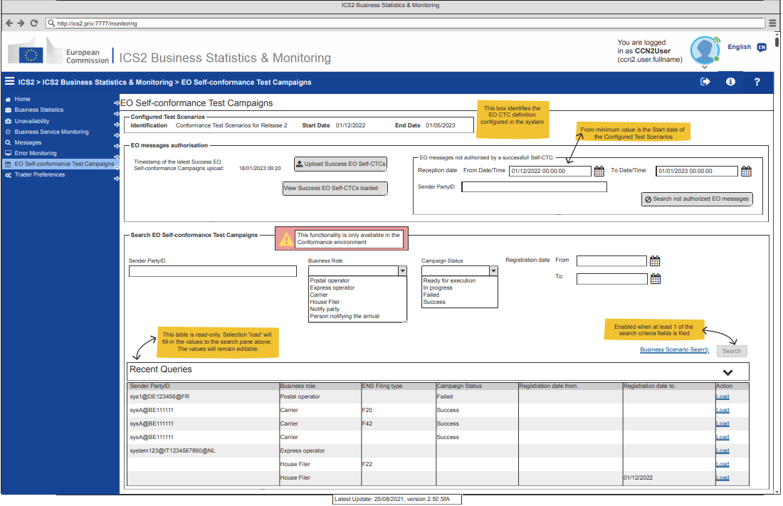
3. MON user interface use cases
EO Self-Conformance Test Campaign

Slide 44
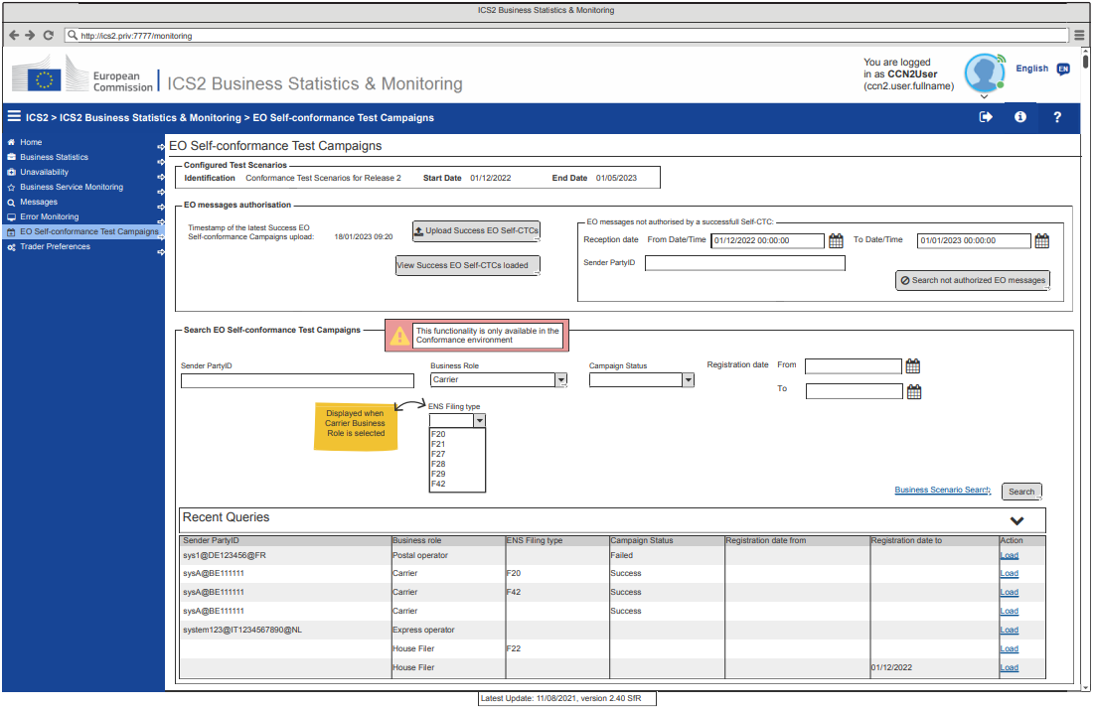
3. MON user interface use cases
EO Self-Conformance Test Campaign: Carrier Search

Slide 45
3. MON user interface use cases
EO Self-Conformance Test Campaign: House Filer Search

Slide 46
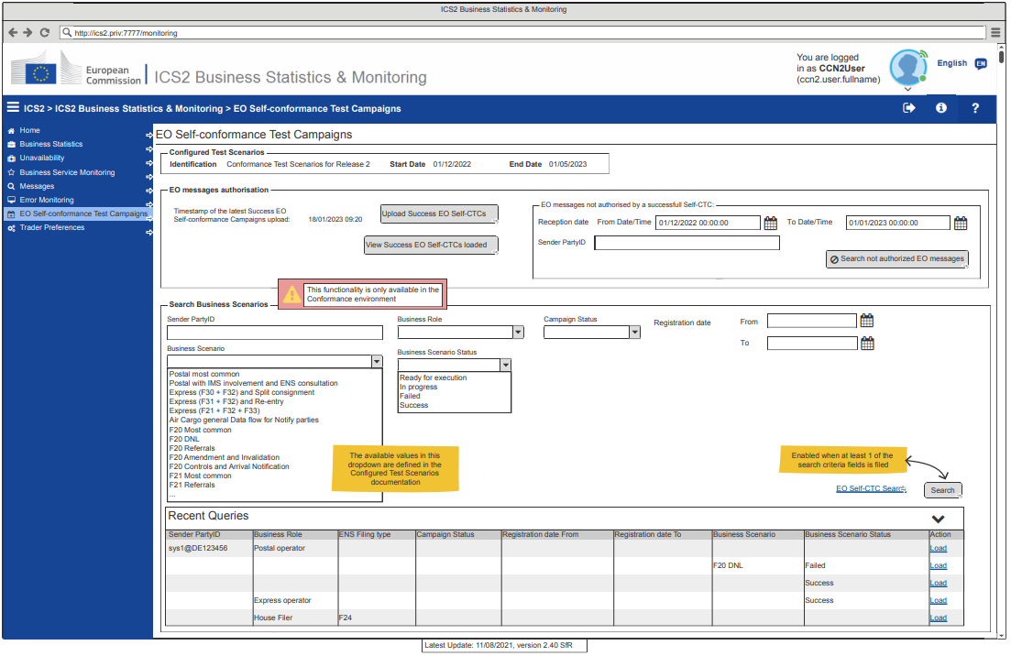
3. MON user interface use cases
EO Self-Conformance Test Campaign: Business Scenario Search

Slide 47
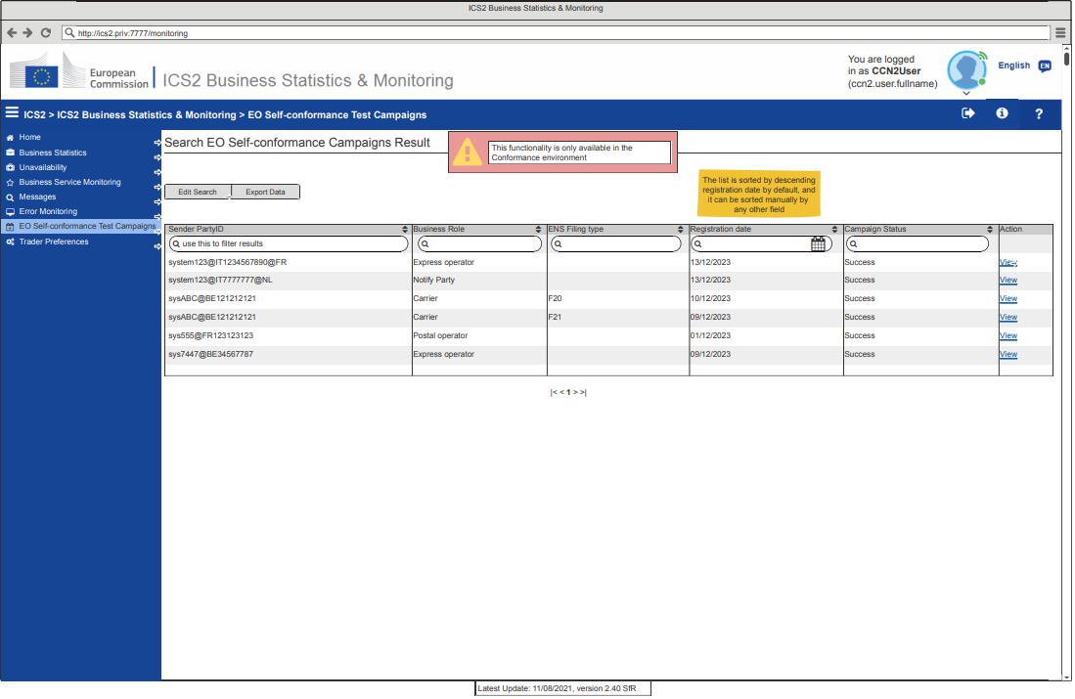
3. MON user interface use cases
EO Self-Conformance Test Campaign: Campaign Result search

Slide 48
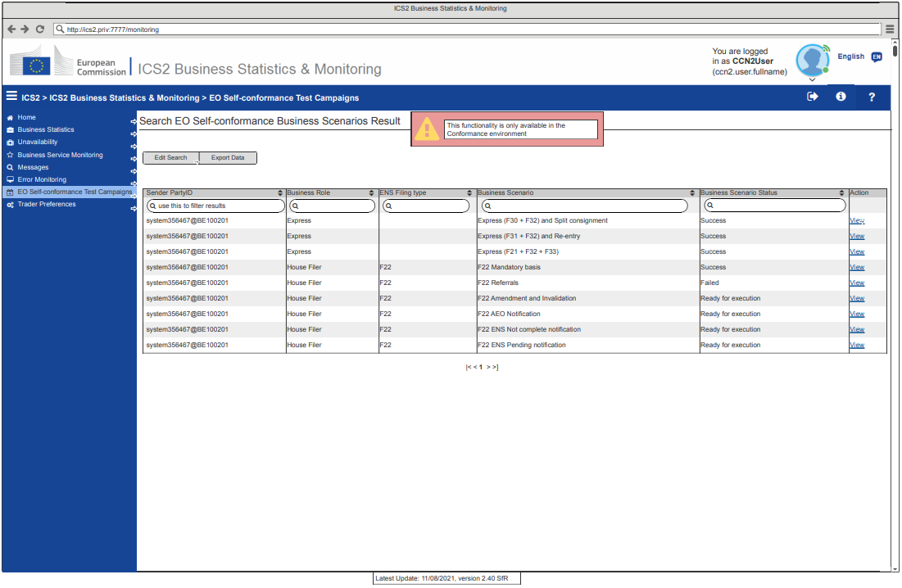
3. MON user interface use cases
EO Self-Conformance Test Campaign: Business Scenario Results search

Slide 49
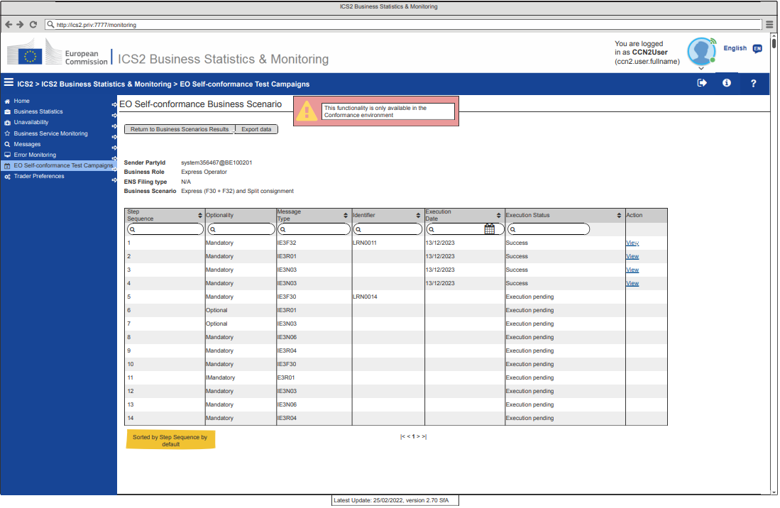
3. MON user interface use cases
EO Self-Conformance Test Campaign: View Business Scenario

Slide 50
3. MON user interface use cases
EO Self-Conformance Test Campaign: Consult Successful EO-Self CTC
The user can consult the successful EO Self-Conformance Campaigns currently loaded in the system.
The user selects to View the successful EO Self-Conformance Campaigns
The system displays a grid with the list of the successful EO Self-Conformance Campaigns currently loaded, with the columns:
Sender PartyId;
Business Role;
ENS Filing type;
Registration Date;
Status.
The Business Scenarios and Messages related to these Self-Conformance Campaigns are not consultable

Slide 51
3. MON user interface use cases
EO Self-Conformance Test Campaign: Consult Successful EO-Self CTC
The system displays the successful EO Self-Conformance Campaigns
For National users the data in the grid will be filtered to the Campaigns where their country is involved, based on the Sender Party Id
In the next slide there is graphical representation of MON&BS UI regarding the “EO Self-Conformance Test Campaign” functionality

Slide 52
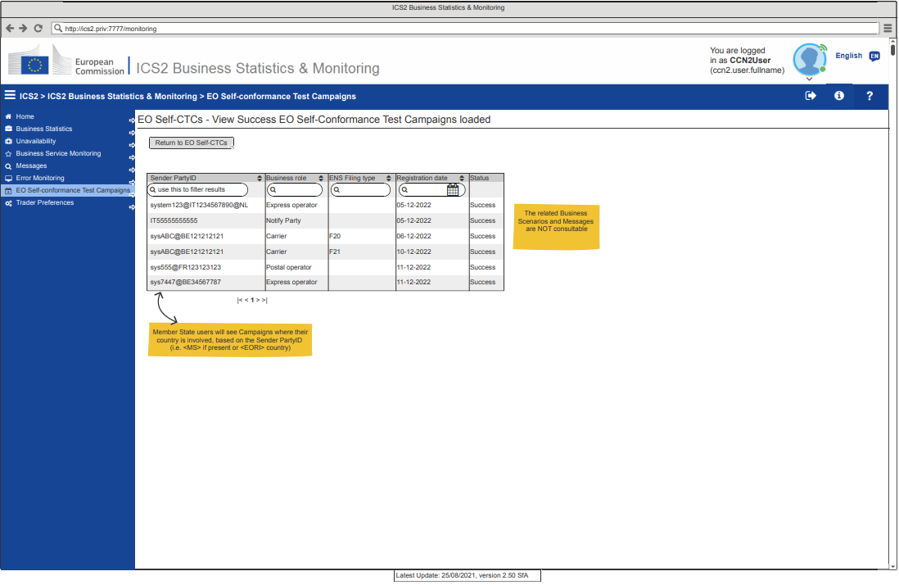
3. MON user interface use cases
EO Self-Conformance Test Campaign: View Success Campaigns Loaded

Slide 53
3. MON user interface use cases
EO Self-Conformance Test Campaign: Upload Successful EO-Self CTCs
The Upload Successful Campaigns page in Production environment is the area where the user can upload a file with the success EO Self-Conformance Test Campaigns, previously downloaded from the Conformance environment.
The file must be downloaded previously, from the Conformance environment, using the Export Data functionality from the EO Self-Conformance Test Campaigns – Search Campaigns Results, with the filter “Success”
The system exports the Campaigns list in CSV format and stores it in the user’s workstation with a pre-filled filename.

Slide 54
3. MON user interface use cases
EO Self-Conformance Test Campaign: Upload Successful EO-Self CTCs
The user can upload a file with the successful EO Self-Conformance Campaigns to be loaded in the system.
The user selects to Upload a new file with the successful EO Self-Conformance Campaigns.
The system renders the Upload Files functionality, which includes a File Browser
The user uploads the file
The systems performs the validations below:
The file must be a .csv file
The format of the file must follow the format of the Export Data (.csv format)

Slide 55
3. MON user interface use cases
EO Self-Conformance Test Campaign: Upload Successful EO-Self CTCs
The values of Business Role and ENS Filing must be allowed values
The Campaign Status of all the entries must be “Success”
If the upload is done by a MS user, the Sender PartyIds must be related to his country
If everything is correct, the system offers a previsualization of the campaigns to be loaded and asks the user to confirm the upload.
If the user confirms, the campaigns are included in the list of successful EO Self-CTC and the messages received with the listed PartyId-Business role will not be marked as not compliant. The campaigns which were already configured in the system will remain. The same for the duplicates, i.e. campaigns in the file being already configured, they will remain.

Slide 56
3. MON user interface use cases
EO Self-Conformance Test Campaign: Upload Successful EO-Self CTCs
The expected format for the file is: Sender PartyID;Business role;ENS Filing type;Registration date;Campaign Status
The allowed values of Business role and ENS Filing type must be the same as the values defined in “ICS2 Test Design Specifications for Economic Operator Conformance Test Cases R2”
The value of the Campaign Status must be Success.
New successful EO Self-CTCs, from the file uploaded, are included in the system
In the next slides there is graphical representation of MON&BS UI regarding the “EO Self-Conformance Test Campaign” functionality

Slide 57
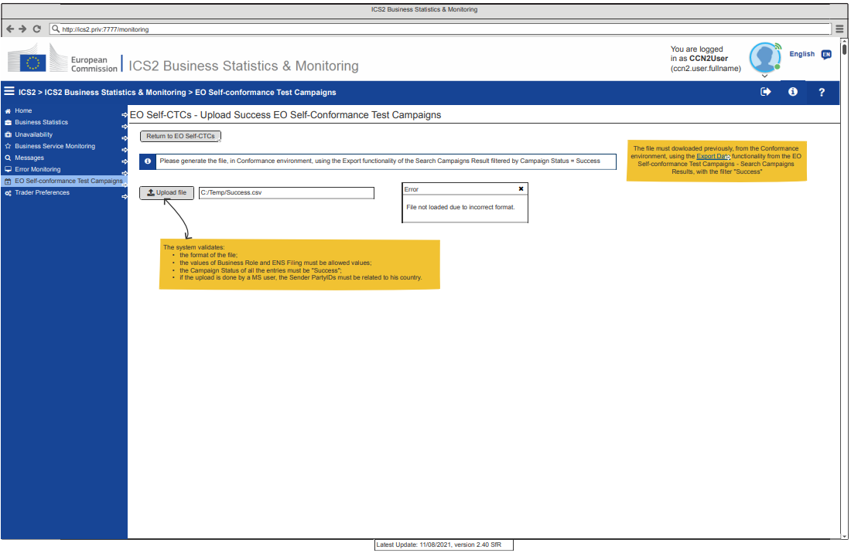
3. MON user interface use cases
EO Self-Conformance Test Campaign: Upload Success Campaigns (error)

Slide 58
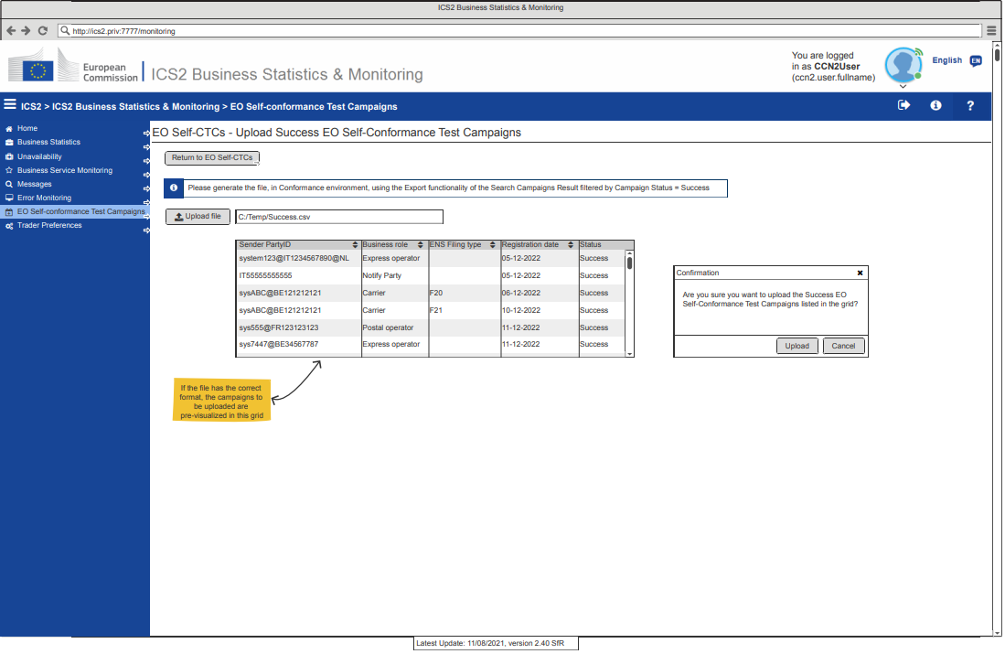
3. MON user interface use cases
EO Self-Conformance Test Campaign: Upload Success Campaigns

Slide 59
3. MON user interface use cases
EO Self-Conformance Test Campaign: Search not compliant messages
The page with the EO messages not authorised by a Self-Conformance Test Campaign, is the area where the system lists messages sent/received by a PartyId which has not completed a successful Self-conformance Test Campaign for this type of message, accordingly to the search criteria introduced by the user previously.
This functionality refers to the Production environment, to allow Member States to search if any EO that has not finished the Self-Conformance Test Campaign for those type of messages is sending them anyway in Production.

Slide 60
3. MON user interface use cases
EO Self-Conformance Test Campaign: Search not compliant messages
The user can search for EO messages with a sender not having performed a successful Self-Conformance Test Campaign for this type of message
The user accesses the EO Self-Conformance Test Campaigns webpage
The system presents the available search criteria to search EO messages not compliant with a successful Self-CTC:
Reception Date (From and To timestamps). The minimum From date allowed is the Start date of the Configured Test Scenario
Sender PartyId

Slide 61
3. MON user interface use cases
EO Self-Conformance Test Campaign: Search not compliant messages
The user enters the intended search criteria and selects to Search EO messages not compliant with a successful Self-Conformance Campaign
The messages with a sending party (EORI of the sending party) not included in the list of Sender parties with successful EO Conformance Testing Campaign for the business role corresponding to the message type are identified.

Slide 62
3. MON user interface use cases
EO Self-Conformance Test Campaign: Search not compliant messages
The system displays EO messages not compliant with a Self-CTC as per the user search criteria
Member State Service-Support Monitoring Operator users have access only to messages related to their country, based on the Sender/Receiver (depending on the message type) PartyId, i.e. MS in which the EORI is registered or MS where the Certificate used in the message is registered in UUM&DS, in case it is different from the MS of the EORI.
In the next slide there is graphical representation of MON&BS UI regarding the “EO Self-Conformance Test Campaign” functionality

Slide 63
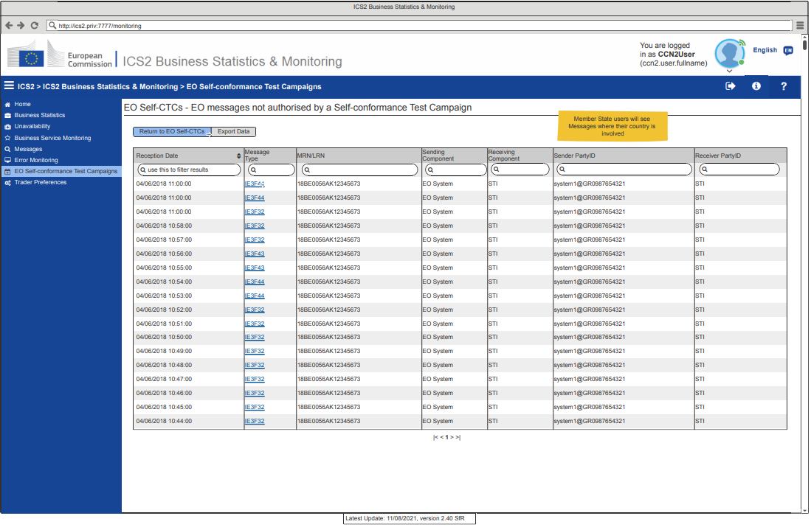
3. MON user interface use cases
EO Self-Conformance Test Campaign: Search not authorized EO messages

Slide 64
Source of Documentation & Material
PICS
https://webgate.ec.europa.eu/pics/filedepot/20607#
CIRCABC
https://circabc.europa.eu/ui/welcome
Customs & Tax EU Learning Portal
https://customs-taxation.learning.europa.eu/
MSs can find useful CT material by accessing these webpages

Slide 66
Thank you
© European Union 2022
Unless otherwise noted the reuse of this presentation is authorised under the CC BY 4.0 license. For any use or reproduction of elements that are not owned by the EU, permission may need to be sought directly from the respective right holders.
Notes:
Update/add/delete parts of the copy right notice where appropriate.
More information: https://myintracomm.ec.europa.eu/corp/intellectual-property/Documents/2019_Reuse-guidelines%28CC-BY%29.pdf

